Slide 1
PARTS OF
SPEECH
DIFFERENT TYPES OF
NOUN

Slide 2
Analyse the sentence and discuss if something is incorrect. (Ignore the errors of punctuation, if any).
Darts are played by men as well as women.

Slide 3
Explanation: 'Darts' is a noun, which 'looks' plural, but is used as 'singular'. The correct sentence should be: Darts is played by men as well as women. To understand this type of errors, we must understand the behavior of nouns. Nouns can be divided into several types, as covered in this and following questions. Nouns that look like plural, but are used as singular
News, Mathematics, Ethics, Linguistics, Phonetics, Politics, Economics, Statistics, Billiards, Darts, Droughts, Innings,
Gymnastics, Classics, Summons,
Mechanics, Gallows
Example:
Incorrect: Mathematics are a difficult subject.
Correct: Mathematics is a difficult subject.
Incorrect: Politics are a dirty game.
Correct: Politics is a dirty game.
The similar explanation applies to the usage of all other words listed above.

Slide 4
Analyse the sentence and discuss if something is incorrect. (Ignore the errors of punctuation, if any).
The sceneries here are not
good.

Slide 5
The
word scenery is
uncountable in English.
It may be countable in some
other languages. However, in English,
we can’t say sceneries or a scenery.
Uncountable nouns do not have plural forms and they
cannot be used with numbers or the article a/an and hence,
the correct sentence should be: The scenery here is not good.
The nouns information, furniture, news, luggage etc., are uncountable.
Example:
Incorrect: He provided the blinds with food.
Correct: He provided the blind with food.
The expressions ‘the blind’, ‘the deaf’,
‘the unemployed’, ‘the dead’, ‘the poor’
etc., are plural. ‘The blind’ means
The similar all blind people. We can’t
explanation applies to say ‘the blinds’ or
the usage of all other ‘the deafs’.
words in the same category.

Slide 6
Analyse the sentence and discuss the pattern of compound noun. (Ignore the errors of punctuation, if any).
Attorneys-general from 16 states condemned the ban yesterday and were discussing whether to challenge the administration in court.

Slide 7
COMPOUND NOUNS
Some nouns consist of more than one word. These are compound nouns. Compound noun is made up of a noun plus another noun. Take moonlight as an example. However, compound nouns are also made using other parts of speech, like verbs and adjectives.
OPEN
(noun + noun)
Eyewitness
Fingerprint
Pickpocket
wheelchair
CLOSED
(noun + noun)
air bag
bomb squad
case study
death rate
HYPHENATED
(noun + noun)
two-fold
by–product
self–defense
city-state
The similar explanation applies to the usage of all other words listed above.

Slide 8
OPEN
CLOSED
HYPHENATED
Black eye
(adjective + noun)
Slam dunk
(verb + noun)
Quick fix (adjective + noun)
Payday
(verb + noun)
Lookout
(verb + adverb)
Breakfast (verb + noun)
Check-in
(verb + preposition)
Well-being
(noun + verb)
Two-fold (noun + noun)

Slide 9


DIFFERENT TYPES OF
PRONOUN

Slide 10
Analyse the sentence and discuss if something is incorrect. (Ignore the errors of punctuation, if any).
My mother bought my brother and I new clothes for the first day of school, even though we insisted we did not want to go.

Slide 11
Subjective
& Objective
Pronouns
Subjective There are some
and objective pronouns that are
pronouns are simply always subjective and
pronouns that occur in either others that are always objective.
subject or the object of the Singular Plural
sentence. Subjective pronouns Subjective I, you, he, we, you,
tell us who or what the sentence is she, it they
about. Objective pronouns Objective me, you, her, us, you,
receive the action in the him, it them
sentence. The sentence should read something
like this: My mother bought my brother
and me new clothes for the first day of school, even
though we insisted we did not want to go. The pronoun I
in this sentence is actually incorrect because it appears
in the object of the sentence.

Slide 12
Analyse the sentence and discuss if something is incorrect. (Ignore the errors of punctuation, if any).
My brother fell off his
bicycle and hurt him.

Slide 13
An intensive
pronoun refers
INTENSIVE back to another noun
(or pronoun) in the
PRONOUNS sentence in order to
emphasize it.
Singular: myself, yourself, Incorrect: My brother fell off
himself, herself, his bicycle and hurt him.
itself The correct sentence
Plural: ourselves, should be: My brother
yourselves, fell off his bicycle and
themselves hurt himself

Slide 14
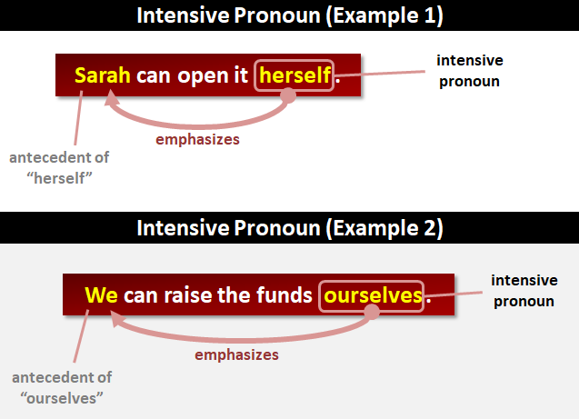

Slide 15
Analyse the sentence and discuss if something is incorrect. (Ignore the errors of punctuation, if any).
What colour do you think I should wear?

Slide 16
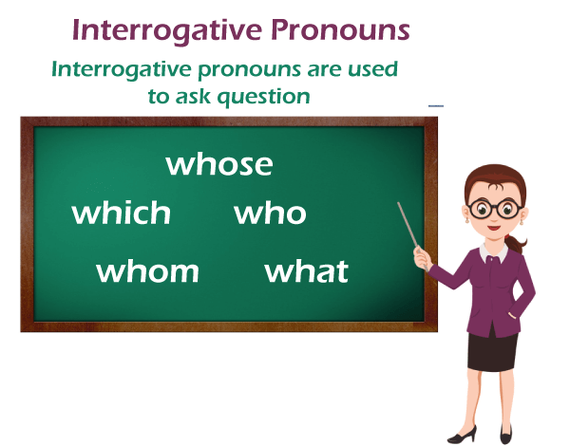
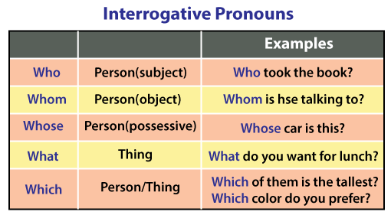

Slide 17
QUESTION | ANSWER
Who told you? | John told me. | subject
Whom did you tell? | I told Mary. | object
What's happened? | An accident's happened. | subject
What do you want? | I want coffee. | object
Which came first? | The Porsche 911 came first. | subject
Which will the doctor see first? | The doctor will see the patient in blue first. | object
There's one car missing. Whose hasn't arrived? | John's (car) hasn't arrived. | subject
We've found everyone's keys. Whose did you find? | I found John's (keys). | object

Slide 18
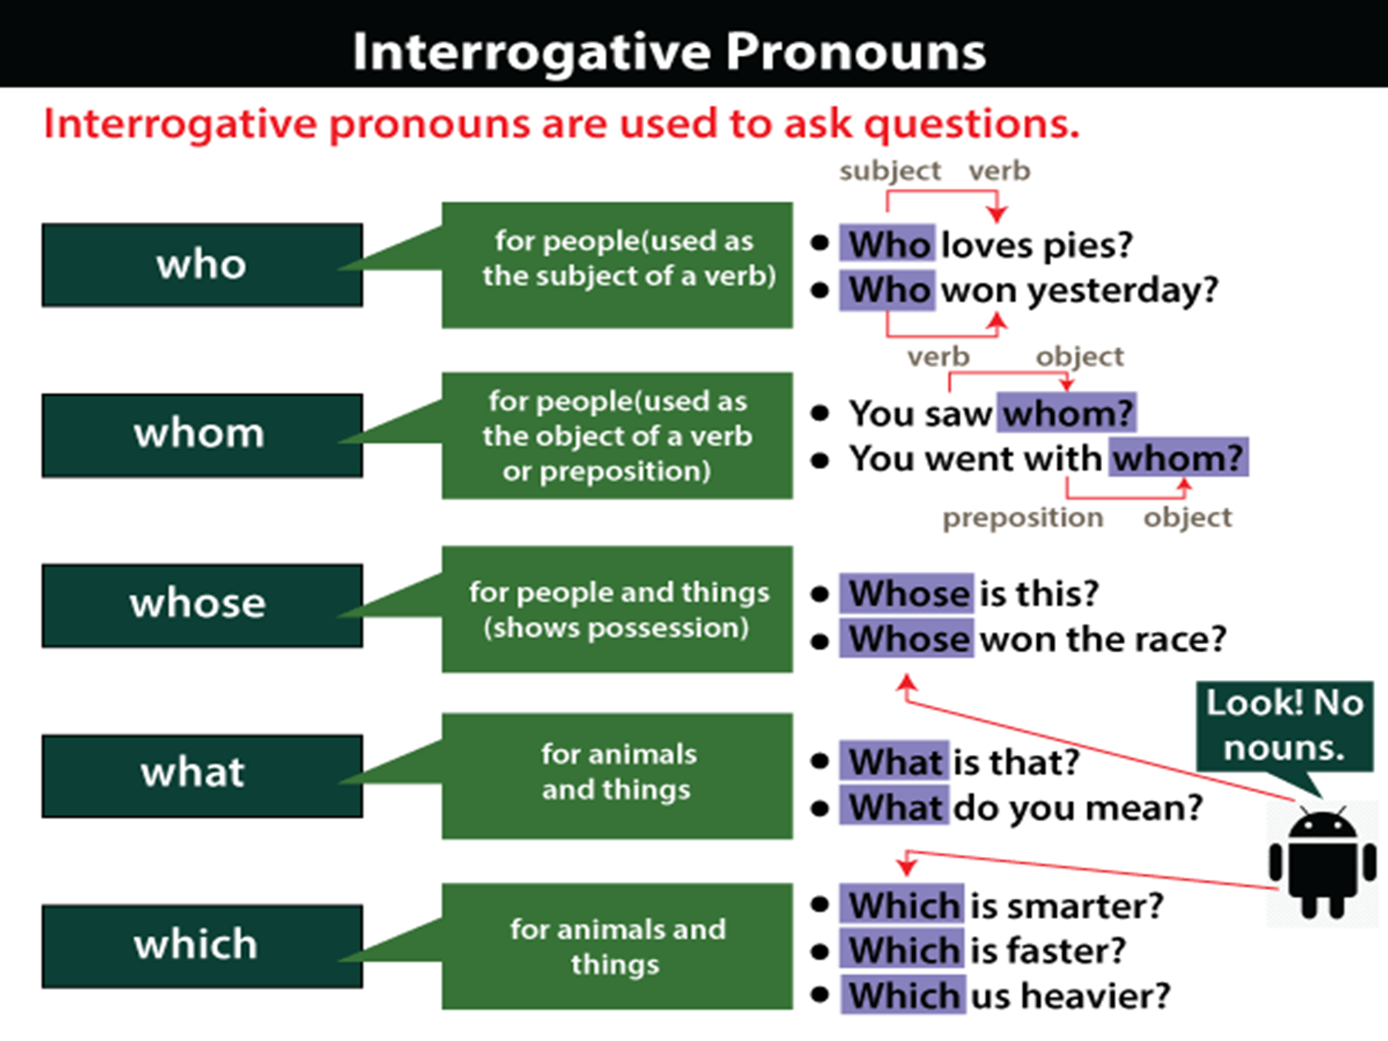

Slide 19
Interrogative Pronouns must not be mixed with Interrogative Determiners.
Interrogative pronouns should not be confused with interrogative determiners (called "interrogative adjectives" in classical grammar), which have the same appearance as interrogative pronouns.
Interrogative determiners are used to change nouns or pronouns.
It is essential to take into account the below mentioned questions:
Which route is the most secure?
What kind of meals are they purchasing?
Whose one should we use?
(The bold texts in these examples are not interrogative pronouns. They function as interrogative determiners. They do not exist in isolation. They are all used to modify nouns or pronouns.)

Slide 20
Compare the preceding instances to the following:
Which is the most secure?
What are they purchasing?
Whose should we use?
(These are all stand-alone. They are interrogative pronoun.)

Slide 21
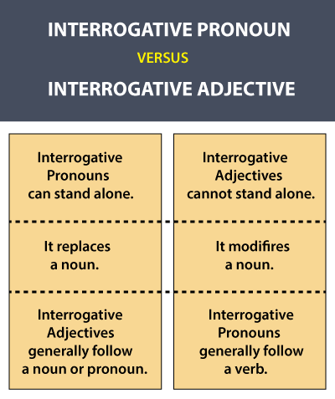

Slide 22
Difference between an Interrogative Pronoun and an Interrogative Adjective
Like demonstrative pronouns and demonstrative adjectives, interrogative pronouns and interrogative adjectives differ based on the roles they play in a sentence. If the word is used to describe more about the noun in the sentence, it would be an interrogative adjective. On the other hand, if it is used to identify or substitute the noun that acts as the subject or object in a sentence, then it is an interrogative pronoun.
Interrogative Pronoun / Interrogative Adjective | Used as an Interrogative Pronoun | Used as an Interrogative Adjective
What | What are you looking for here? | What colour do you think I should wear?
Who | Who is the man who stole your purse? | ‘Who’ cannot be used as an interrogative adjective as it always refers to people who are nouns that play the role of a subject or an object.
Whom | Whom did you bring along with you for the wedding? | ‘Whom’ cannot be used as an interrogative adjective as it always refers to people who are nouns that play the role of a subject or an object.
Whose | So many of them had lost their phones that night. Whose did you find? | Whose acting did you like the most?
Which | Which is the book you read last month? | Which book did you decide to buy?

